Slide 1
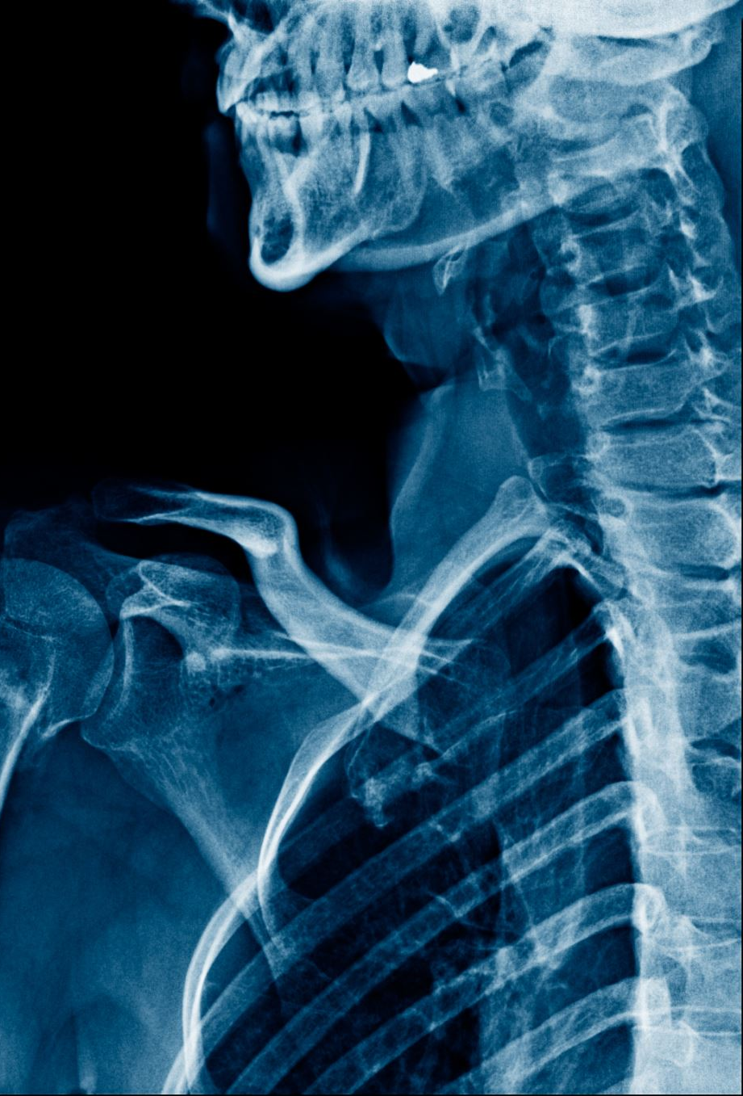
Chest X-Ray Diagnosis through a Convolutional Neural Network
By Andrew Dant & Alicia Hernandez

Slide 2
Introduction
Chest x-rays are relatively common and inexpensive
Interpreting can be challenging and require domain specific expertise
Inherent need for speed and accuracy
Assist medical staff in diagnoses
Ability to diagnose with information outside of their education/experience
Proposal
Using both x-ray imaging and a corresponding dataset with patient details, we aim to use a convolutional neural network to quickly and accurately assist medical staff through the diagnosis process.

Slide 3
Challenges
Image classification relies upon large datasets
Only expert radiologists can preform x-ray labeling
Renders datamining erroneous
Forces weakly supervised learning
Potential for inaccurate diagnoses if category:
does not have enough data
X-rays done with articles of clothing that may cause disruption (such as a wired bra)

Slide 4
Background research
Keras.io
Uses a keras function to break down MRI images
Generates diagnoses and accuracy %.
Science Direct
Aimed to assist medical staff in diagnosing COVID-19 via chest x-rays.
Uses a deep convolutional neural network to detect COVID-19
Noted that words on x-rays may create bias but does not affect overall accuracy
Suggests random under sampling data to ensure balance

Slide 5
Data Description
112,120 frontal-view x-ray images
30,805 unique patients
Text-mined fourteen disease image labels
May contain multiple labels
12 categories of images
4000+ images per set
Images are .png
Each image is identified by corresponding ID
Categories are not equally represented
Concurs with research that random under sampling may be required
Dataset
Corresponding ID to x-ray images
11 columns with 112,120 unique observations
Columns:
Image Index
Finding Labels
Follow-up
Patient ID
Patient Age
Patient Gender
View Position
Original Image [Width] and [Height]
Original Image Pixel Spacings [x] and [y]

Slide 6
Methodology

Slide 7
Code

Slide 8
Results

Slide 9
Conclusion

Slide 10
References

